Slide 1
Digital Portfolio
STUDENT NAME: VINOTH M S
REGISTER NO AND NMID: 64625A437EFE41ABF7B4290F0D2E27CB
DEPARTMENT: BCA
COLLEGE: VELTECH RANGA SANKU ARTS COLLEGE/ UNIERSITY OF MADRAS

Slide 2
PROJECT TITLE
STUDENT DIGITAL PORTFOLIO USING FRONT END DEVELOPMENT

Slide 3


AGENDA
Problem Statement
Project Overview
End Users
Tools and Technologies
Portfolio design and Layout
Features and Functionality
Results and Screenshots
Conclusion
Github Link
3/21/2024 Annual Review

Slide 4

PROBLEM STATEMENT
Traditional resumes or project lists lack interactivity and visual engagement . There is a need for a centralized, interactive digital platform to showcase skills, project, and achievements. A digital portfolio provides an interactive and accessible platform to present achievements, skills, and experiences.

Slide 5

PROJECT OVERVIEW
Developed a personal portfolio website to showcase my works and skills.
Built using HTML for structure, CSS for styling, and JavaScript for interactivity.
The site features key sections:
Home, About, Projects, and Contacts.
Clean and modern UI using the Poppins font and color palette(#f8f9fa,#1a0b0b).
Navigation bar allows smooth access to different sections of the page.
Introduced basic interactivity using JavaScript(e.g., form submission alert).
Designed for responsiveness and simplicity-ideal for both desktop and mobile users.
Highlighted personal branching with, roles, and a “View My Work” call-to-action.
Aimed at demonstrating front-end-development skills and UI/UX understanding.

Slide 6

WHO ARE THE END USERS?
1.Students
Use it for academic projects and resumes.
Helps showcase skills learning in a practical format.
2.Job Seeker
Share their work with recruiters.
Demonstrates technical ability and creativity.
3.Freelancers
Present projects or prototypes to clients.
Aids in securing freelance gigs by showing live examples.
4.Professionals
Highlight work experience and achievements.
Build portfolios or dashboards for professional growth.

Slide 7

TOOLS AND TECHNIQUES
HTML→ Structure(page, sections).
CSS →Styling(colors, layouts, responsiveness).
JavaScript →Interactivity (navigation menu, animations, form validation).
CODEPEN and hosting platform(GitHub Pages).

Slide 8
PORTFOLIO DESIGN AND LAYOUT
1.Sections:
Hero Section.
Project Section.
Contact Section.
Header Section.
Footer Section.
About Section.
2.Home/About Me.
3.Skills.
4.Contact.
5.Responsive layout(mobile + desktop view).
8

Slide 9
FEATURES AND FUNCTIONALITY
Navigation bar with smooth scrolling.
Personal Branding.
Project showcase with images/details.
Responsive Design
CSS Styling & Resets.
Animations/Transitions.
Semantic HTML.
Form Handling with JavaScript.

Slide 10
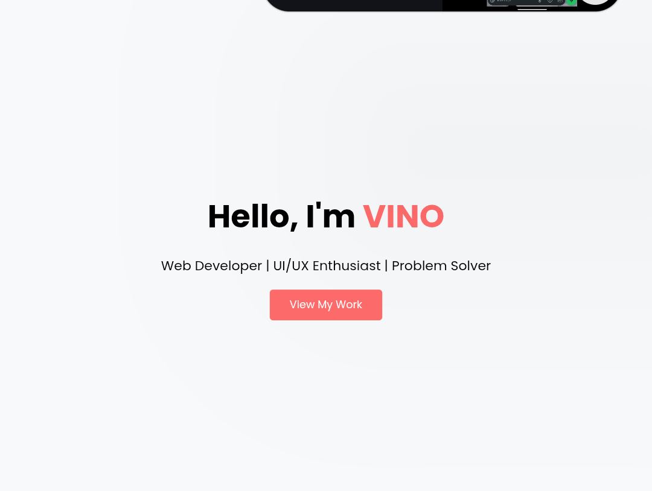
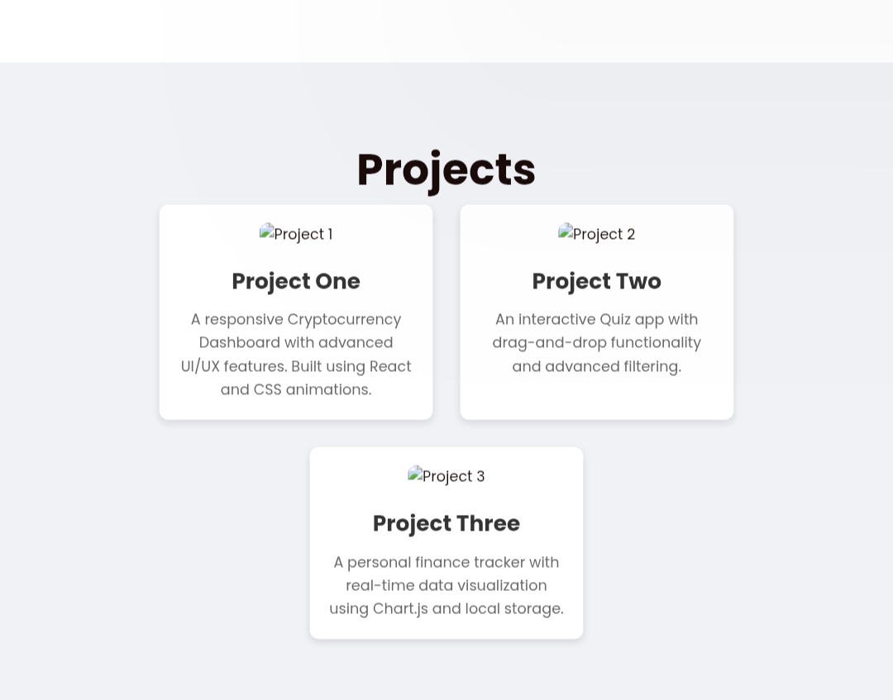

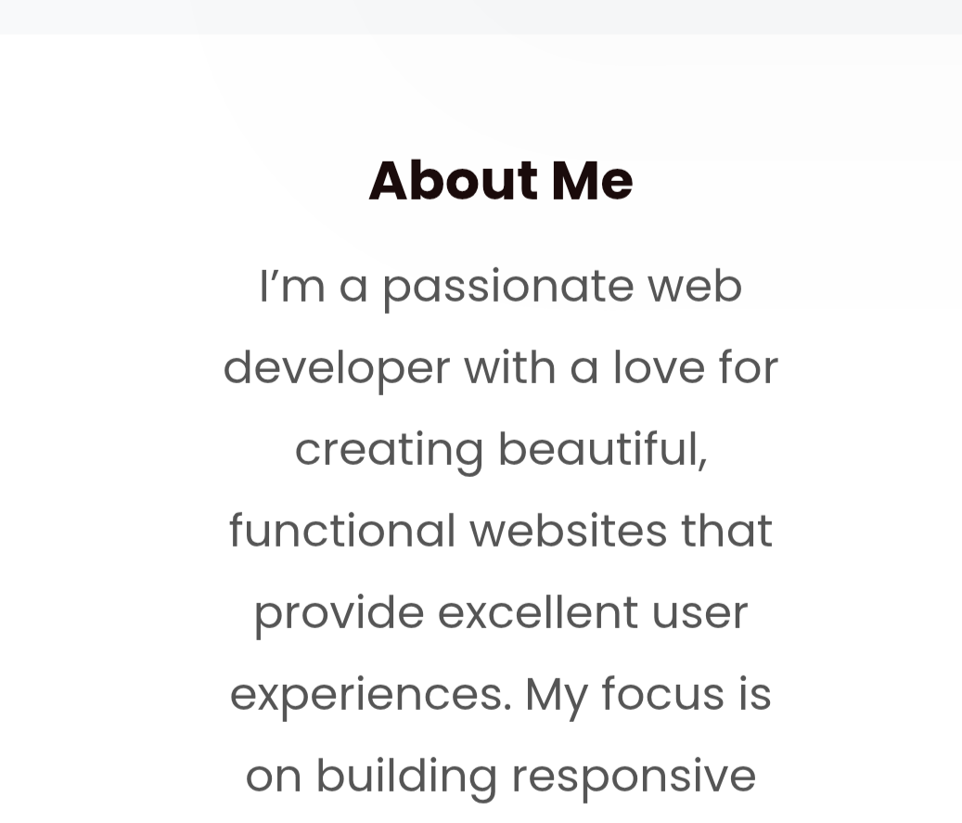
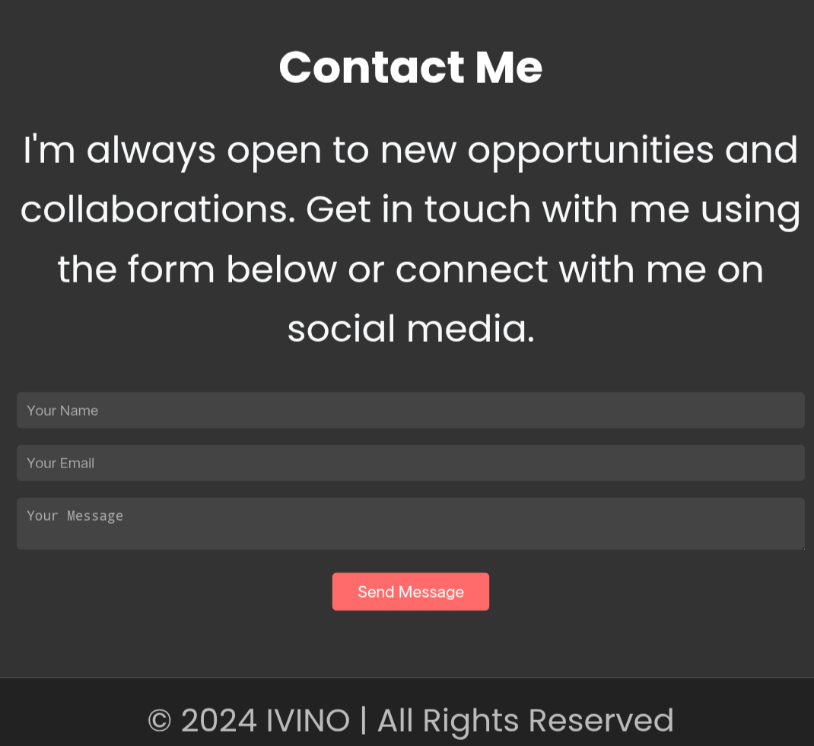
RESULTS AND SCREENSHOTS
3/21/2024 Annual Review
10

Slide 11
CONCLUSION
The digital portfolio is a modern way to present yourself professionally online. It demonstrates not just content but also your ability to design, code, and delay a product.
11

